Slide 1
CS 528 - DEMO 4
Stop Wasting the Cloud
Mentors:
Dan Macpherson
Patrick Dillion
Team Members:
Anshu Goel
Jhukhirtha Marhi Arokiasamy
Sahil Gupta
Sidharth Bakshi
Vedant Mahabaleshwarkar
Notes:
aks

Slide 2
Recap
Vision: Utilize slack resource in each node to run BOINC jobs
Sprint 1: We had already containerized BOINC based CentOS image in our local machines.
Sprint 2 Goal: Deploy the image on MOC as Daemonset and research how it scales and interacts with other pods
Sprint 3: Set up Cgroup limit for BOINC and perform initial benchmarking tests
Notes:
Deploy a BOINC based CentOS image on the Openshift cluster in the MOC as a daemonset.
Communicate C- group values to BOINC and perform the Benchmarking test Procedure
Limit limited our BOINC jobs to Cgroup memory limit because Without cgroup limit BOINC was trying to utilising the resources allocated for other tasks
Deploy non-boinc jobs in a manner that we can understand if our boinc jobs are affecting the way the non-boinc jobs perform.

Slide 3
Benchmarking strategy
We decided to mock the primary app with BOINC
BOINC has a point system that awards points based on the tasks completed
Heavier tasks get more points and the same task would get the same number of points regardless of how powerful the hardware is
We used points generated per hour to gauge how the primary load performed under different secondary loads
Notes:
T
We set out to perform benchmark test to u Deploy primary jobs- boinc jobs()
Secondary jobs-
with different configurations in a manner that we can understand how it affects boinc jobs are affecting the way the non-boinc jobs perform.
Deploy non-boinc jobs in a manner that we can understand if our boinc jobs are affecting the way the non-boinc jobs perform.

Slide 4
Benchmarking configurations
Primary application with 50% load:
No secondary load
Secondary BOINC - burstable upto 25%
Secondary BOINC - burstable upto 50%
Secondary BOINC - burstable upto 75%
Primary application with 75% load:
No secondary load
Secondary BOINC - burstable upto 25%
Secondary BOINC - burstable upto 50%
Secondary BOINC - burstable upto 75%

Slide 5
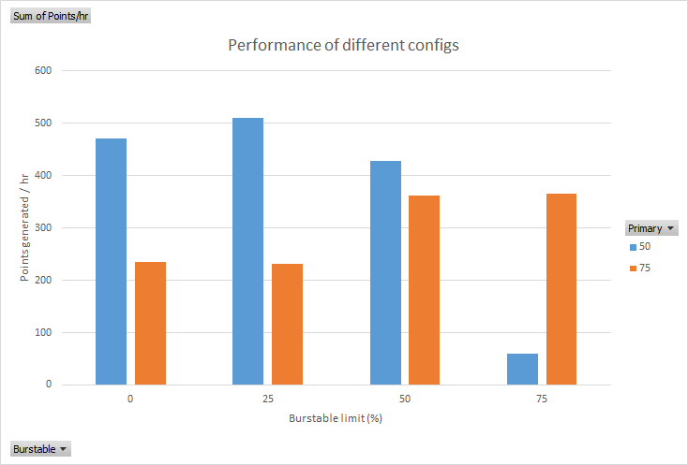
Results of benchmarking

Slide 6
Why we got inconsistent results
BOINC spawns processes based on the number of cores of the system
For each node, BOINC sees 10 cores but the cgroup limits it to a lower amount
This results in a lot of processes going in and out of sleep state
No points are awarded till a task is complete
Hence, even if you run 50 % of 10 tasks, you will not be rewarded any points, although you had computed 5 tasks worth of compute

Slide 7
Issues mocking BOINC as primary job
BOINC is built in such a way that tries not to contest much with other processes
For example, BOINC suspends itself if the non-BOINC workload exceeds x% of the total resources
Hence, using BOINC as both the primary and secondary load would lead to unpredictable behaviour
Hence, the primary application might not behave consistently across different secondary workloads

Slide 8
Alternative Primary Application
Option 1 :
Deploying simple multi-threaded C program to find all prime numbers till 100k
Write success in log file each time process completes the task
Performance of application is directly proportional to count of success in log files
Option 2 :
Use sysbench

Slide 9
New Configuration for Benchmarking
Resource Quota for our project: Memory: 100 Gb CPU: 20 Different configuration for Benchmark testing:
Node 1: Primary Application in burstable tier with limit 70% resources of the node Node 2: Primary Application in burstable tier with limit 70% resources of the node and BOINC job in burstable tier with limit as 30% resource of the node Node 3: Primary Application in burstable tier with limit 70% resources of the node and BOINC job in burstable tier with limit as 70% resource of the node
Note: Each node has 10 cores

Slide 10
Results
Number of success writes on node 1: 268630
Number of success writes on node 2: 27962
None of the pods got killed as we had already limited our BOINC jobs to Cgroup memory limit
BOINC is clearly affecting the performance of primary application
Workaround to optimize it further will be to provide buffer to our BOINC jobs

Slide 11
Ways to make BOINC non-aggressive
Various parameters available in BOINC configuration file
Use at most N % of the CPUs: Keeps some CPUs free for other applications. Example: 75% means use 6 cores on an 8-core CPU.
Use at most N % CPU time: Suspend/resume computing every few seconds to reduce CPU temperature and energy usage. Example: 75% means compute for 3 seconds, wait for 1 second, and repeat.
When computer is in use, use at most N %: Limit the memory used by BOINC when you're using the computer.
When computer is not in use, use at most N%: Limit the memory used by BOINC when you're not using the computer.
Commands to make BOINC further non-aggressive
—no_gpus: We can configure BOINC in manner that it does not uses GPU
—fetch_minimal_work: Fetch only 1 job per device (CPU, GPU).

Slide 12
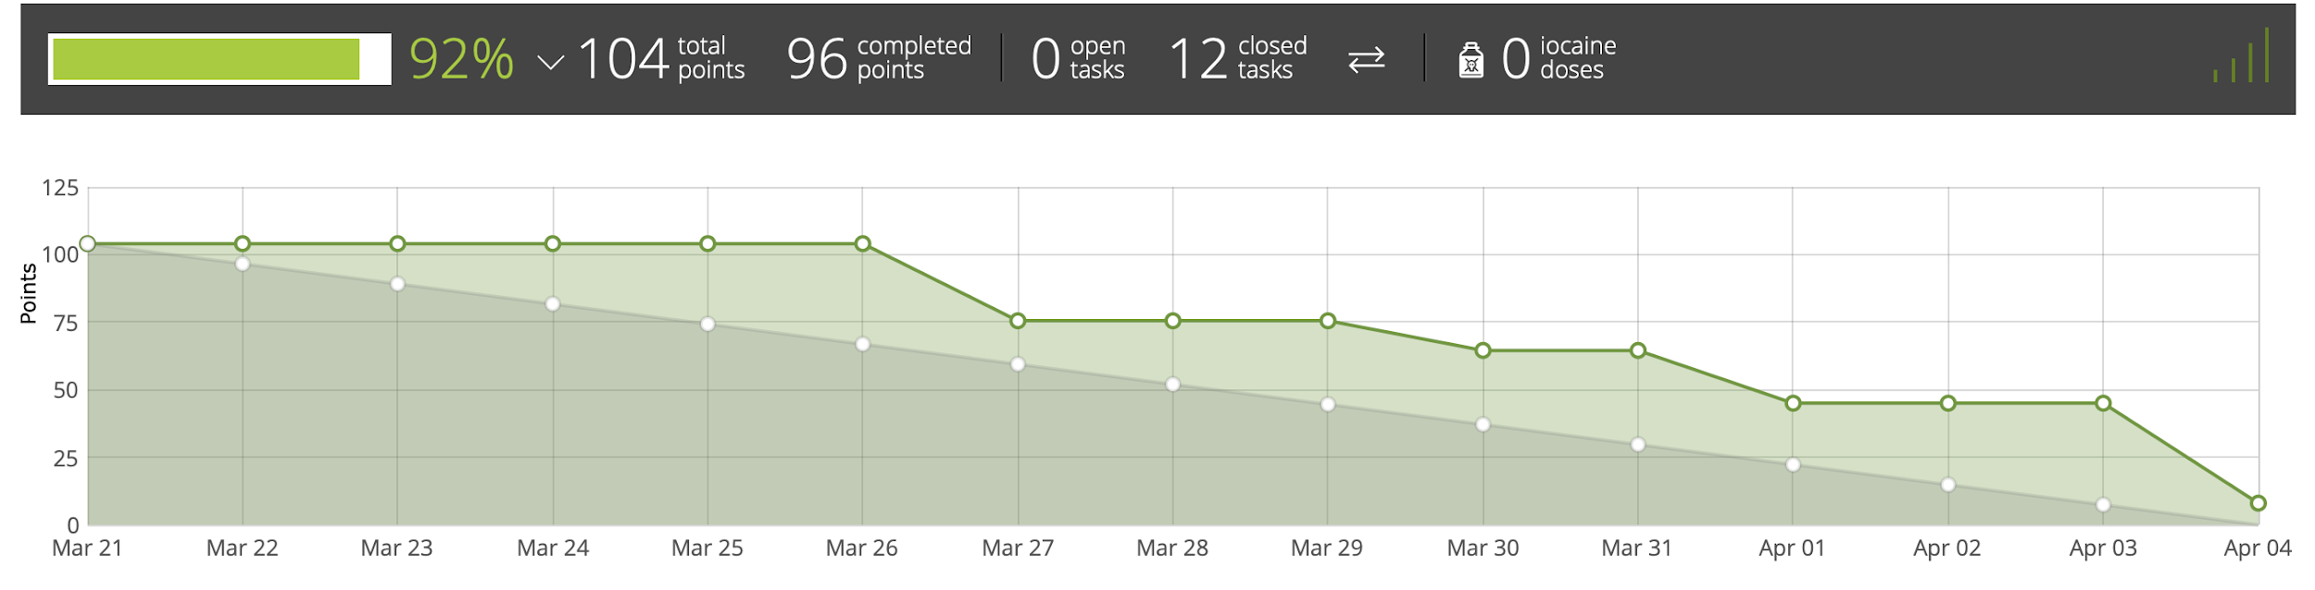
Burndown Chart

Slide 13
Future Sprints
Sprint 5: 18th April 2019
Tune boinc to make it less aggressive and not affect the primary application
Try to figure out a method to have the pods resume from the state they were in before they got killed.

Slide 14
QUESTIONS?

